Slide 1
Student Portfolio
Jenny Kettler

Slide 2
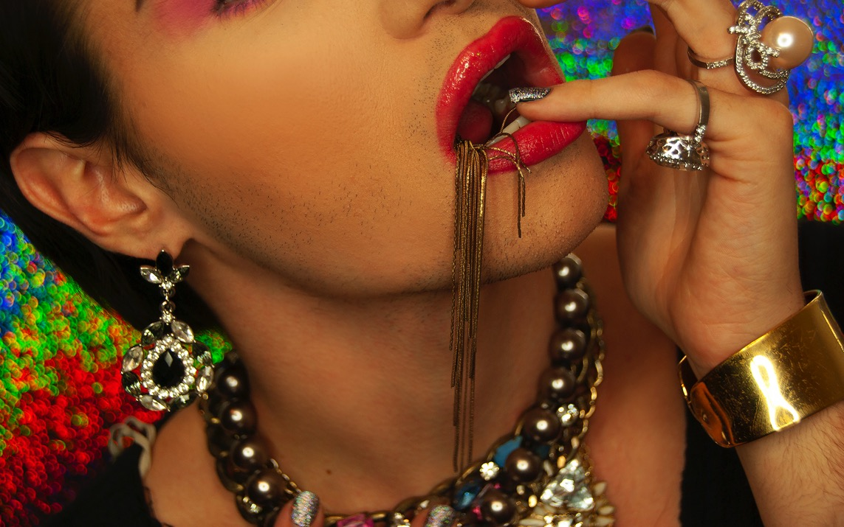
Madalyn Douglass, Conceptual Assignment - Identity & Consumerism, Intermediate Photography,
Southern Illinois University-Edwardsville, 2019

Slide 3
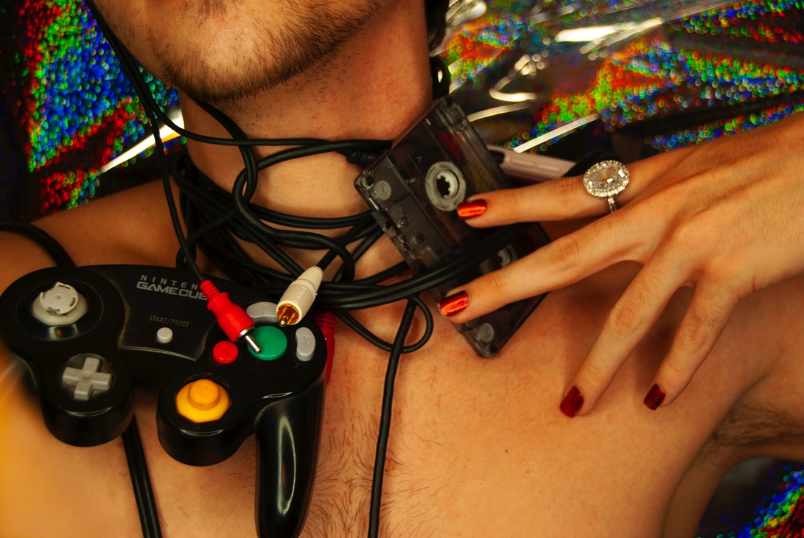
Madalyn Douglass, Conceptual Assignment - Identity & Consumerism, Intermediate Photography,
Southern Illinois University-Edwardsville, 2019

Slide 4
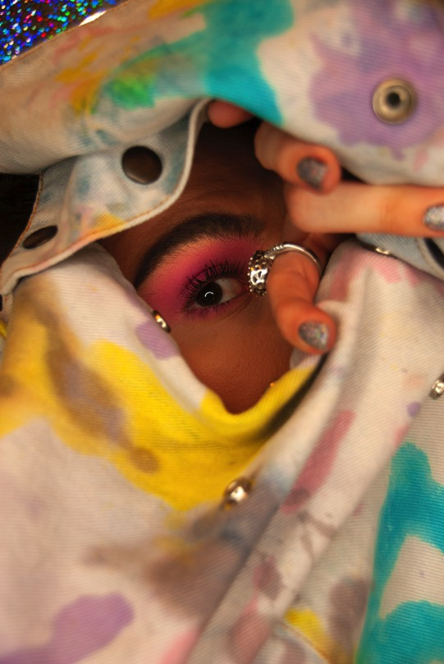
Madalyn Douglass
Conceptual Assignment -Identity & Consumerism
Intermediate Photography
Southern Illinois University-Edwardsville, 2019

Slide 5
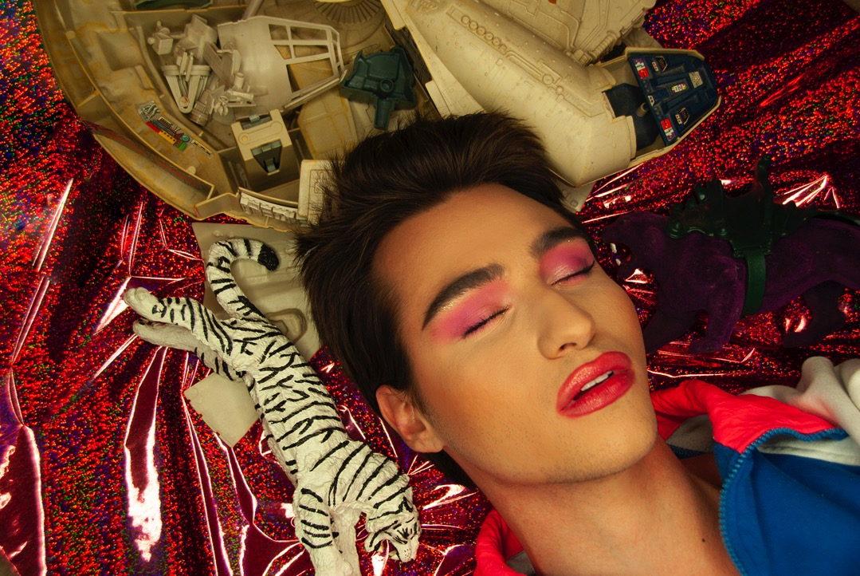
Madalyn Douglass, Conceptual Assignment - Identity & Consumerism, Intermediate Photography,
Southern Illinois University-Edwardsville, 2019

Slide 6
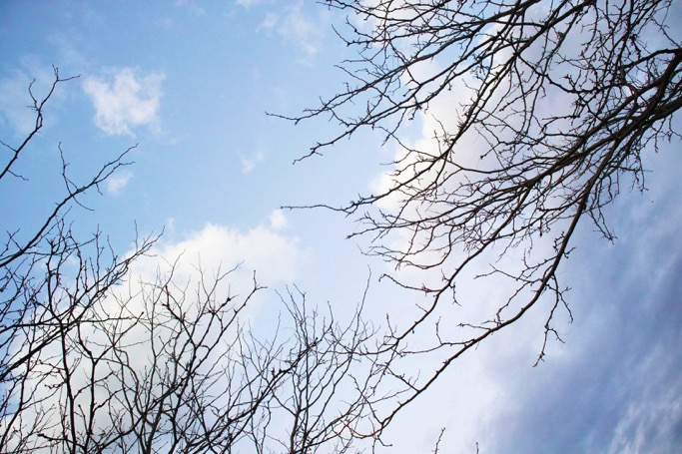

Hina Sano, Final Project – Seeing, the Unseen, Photography 1, Lindenwood University, 2021
Notes:
Hina Sano

Slide 7
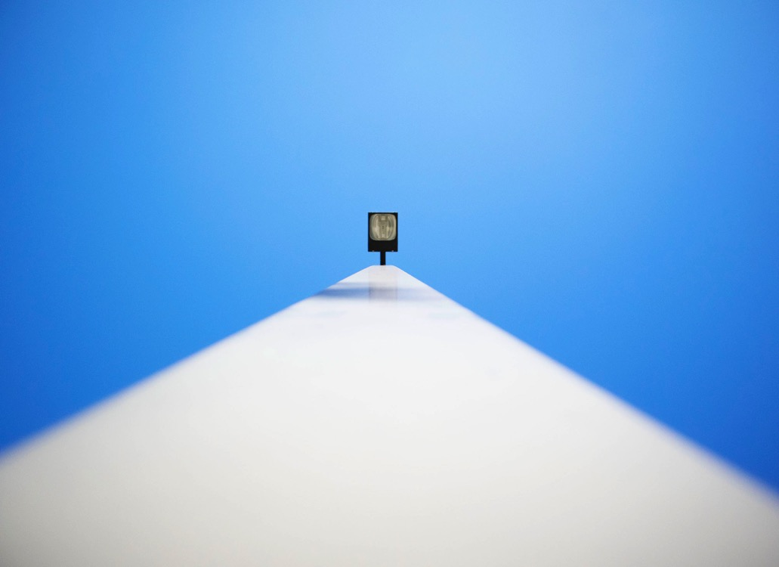
Hina Sano, Final Project – Seeing, the Unseen, Photography 1, Lindenwood University, 2021
Notes:
Hina sano

Slide 8
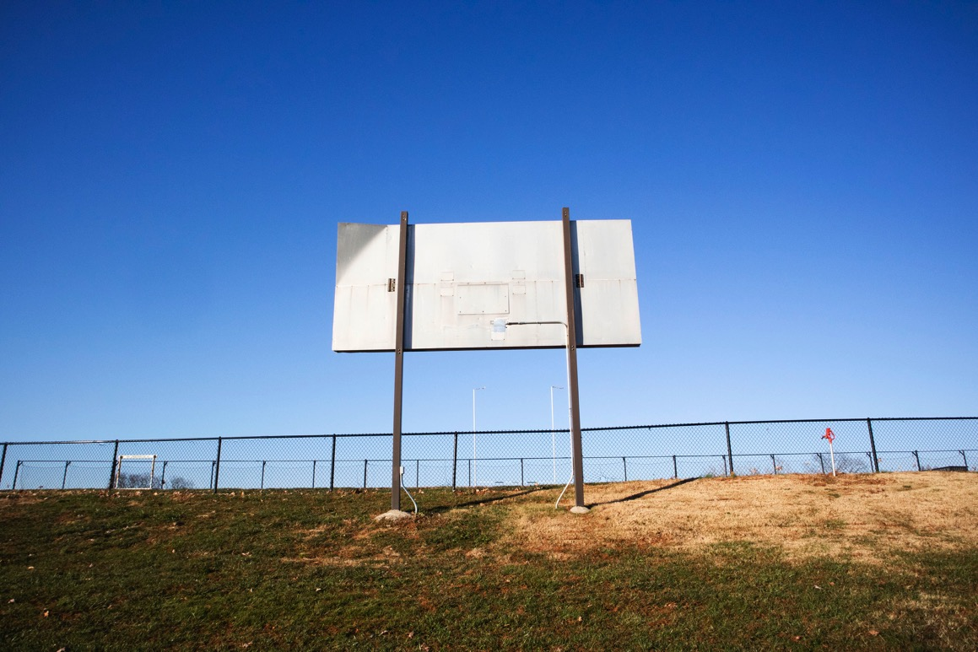
Hina Sano, Final Project – Seeing, the Unseen, Photography 1, Lindenwood University, 2021

Slide 9
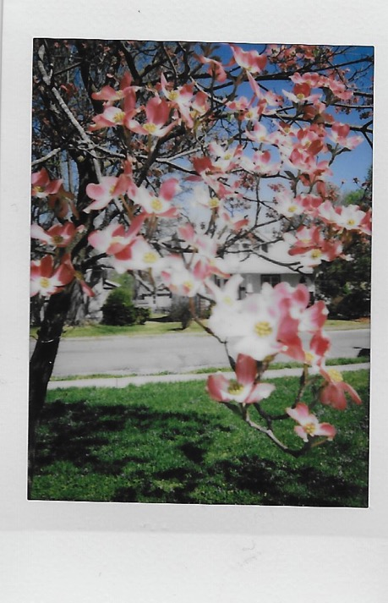
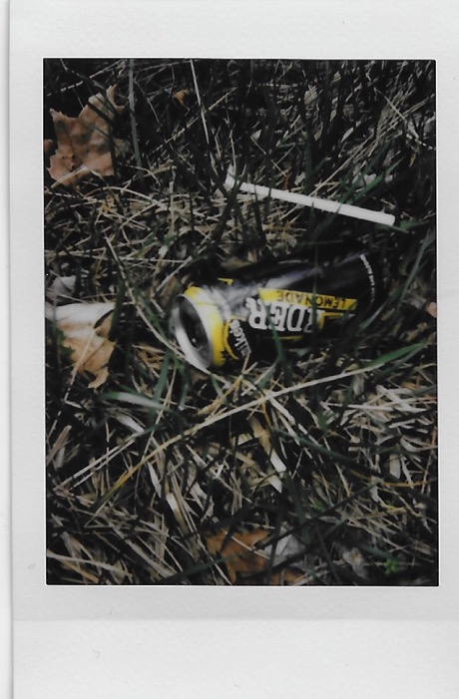
Abi Waters, Polaroid Diptychs, Final Project - Pathways and Possibilities, Digital Photography, Southern Illinois University-Edwardsville, 2018

Slide 10
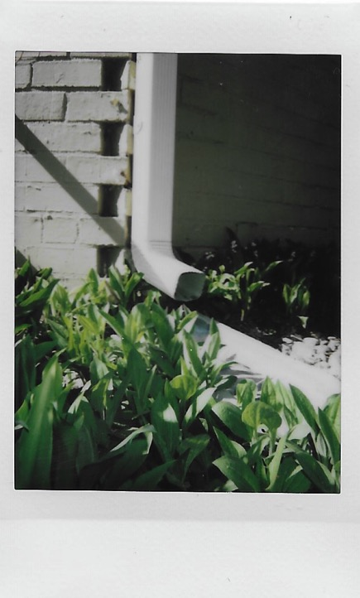
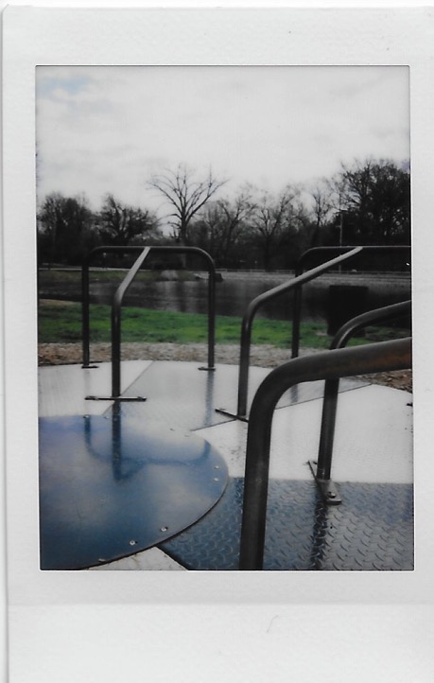
Abi Waters, Polaroid Diptychs, Final Project - Pathways and Possibilities, Digital Photography, Southern Illinois University-Edwardsville, 2018

Slide 11
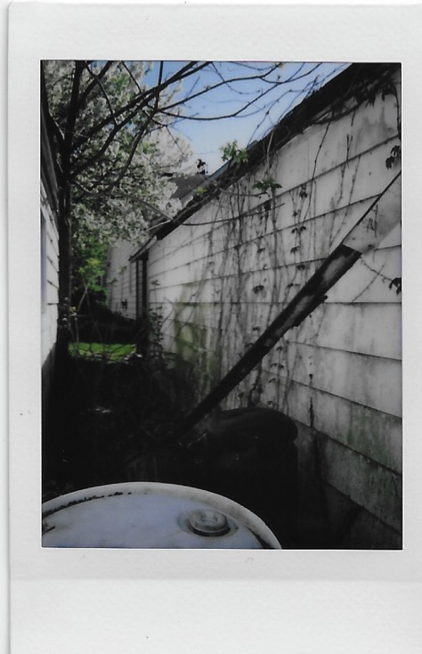
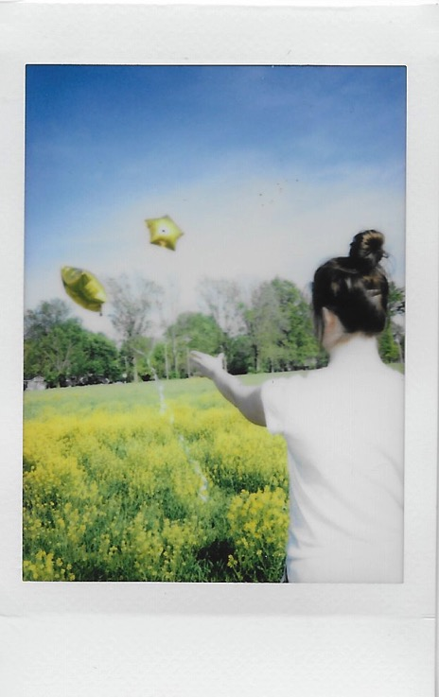
Abi Waters, Polaroid Diptychs, Final Project - Pathways and Possibilities, Digital Photography, Southern Illinois University-Edwardsville, 2018

Slide 12
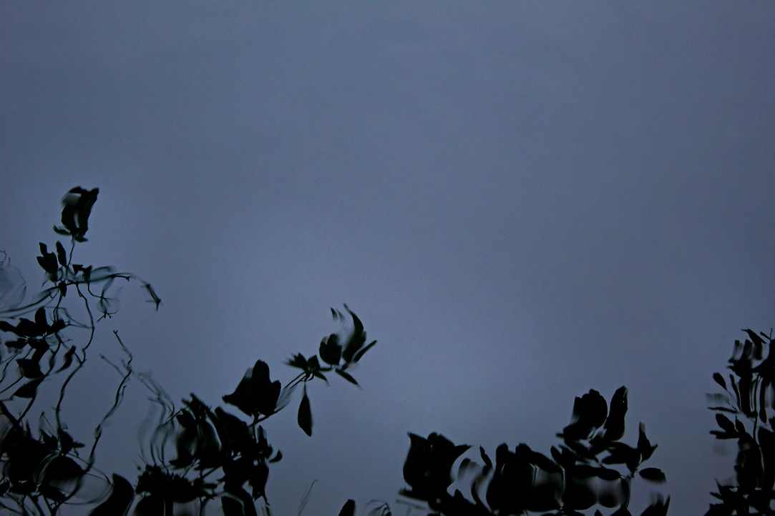
Prairie Boschulte, Homage to Alfred Stieglitz Equivalent series – Water Reflections, Special Topics - Nature Photography Southern Illinois University – Edwardsville, 2018

Slide 13
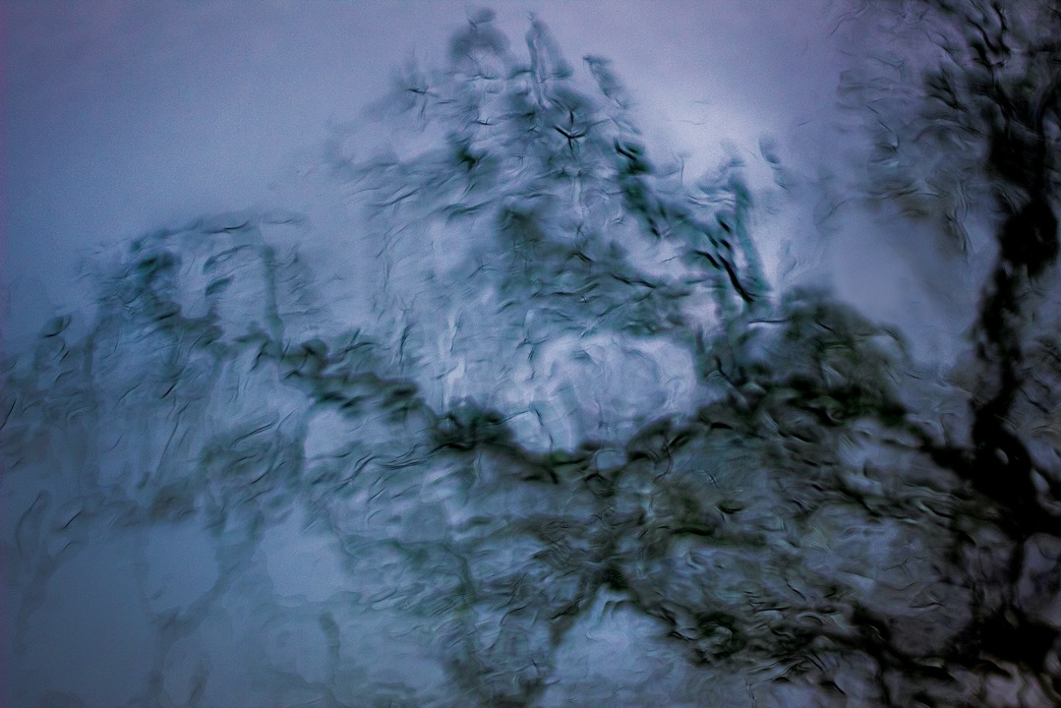
Prairie Boschulte, Homage to Alfred Stieglitz Equivalent series – Water Reflections, Special Topics - Nature Photography Southern Illinois University – Edwardsville, 2018

Slide 14
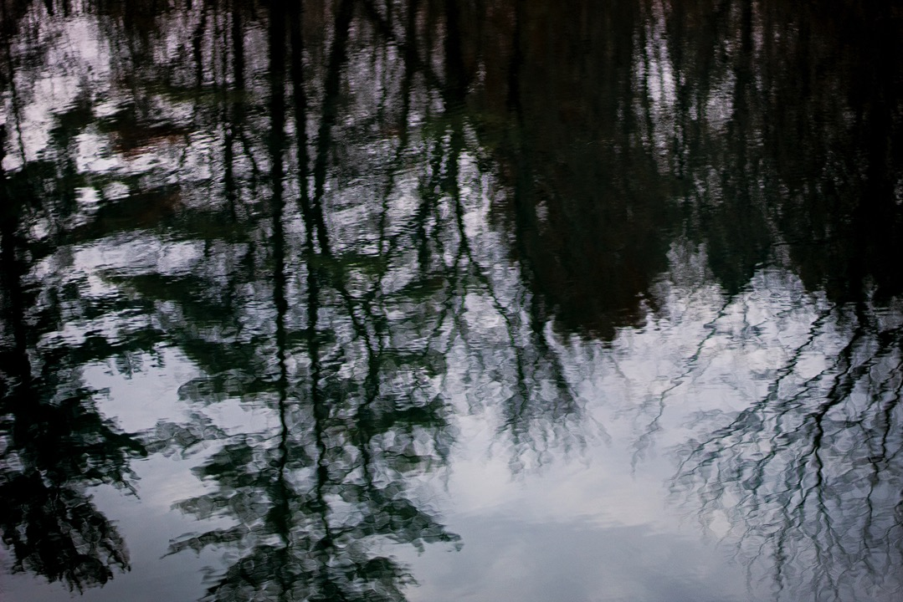
Prairie Boschulte, Homage to Alfred Stieglitz Equivalent series – Water Reflections, Special Topics - Nature Photography Southern Illinois University – Edwardsville, 2018

Slide 15
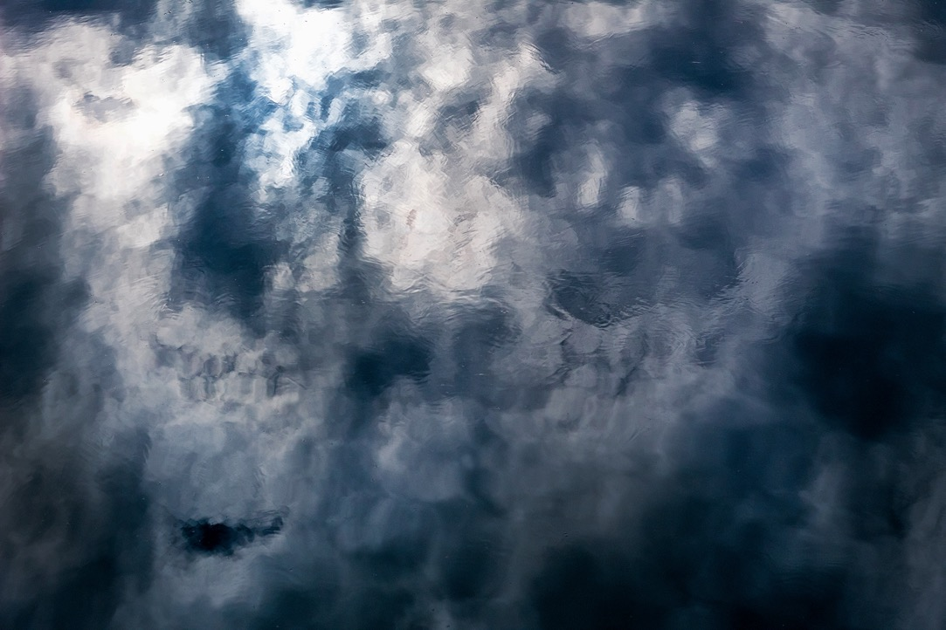
Prairie Boschulte, Homage to Alfred Stieglitz Equivalent series – Water Reflections, Special Topics - Nature Photography Southern Illinois University – Edwardsville, 2018

Slide 16
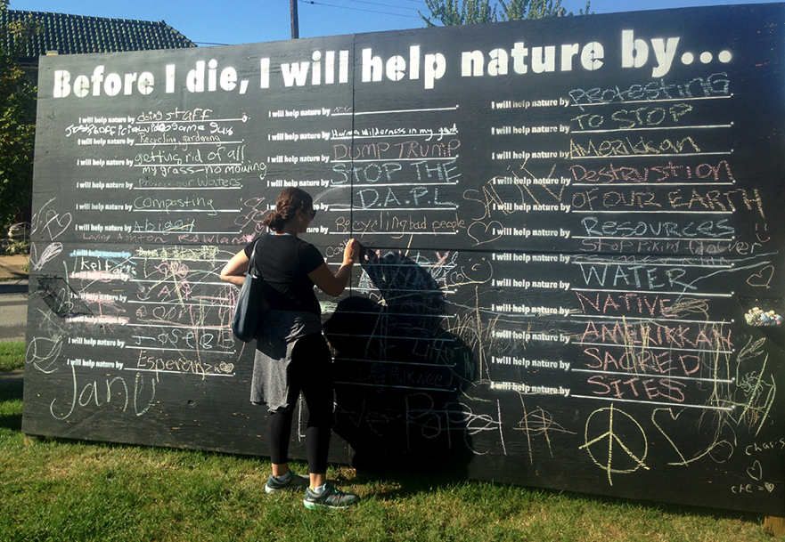
Student installation for Project Preparation, Before I Die, I will help nature by...Project, Art Institute of St. Louis, 2015

Slide 17
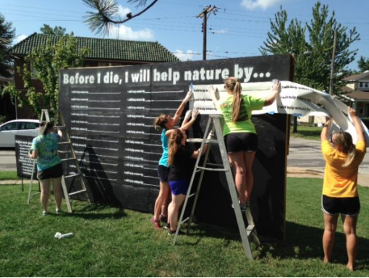
Created in partnership with City of Maplewood & Home Depot. Installed in Ryan Hummert Park, in St. Louis, Mo, August – October 2015

Slide 18
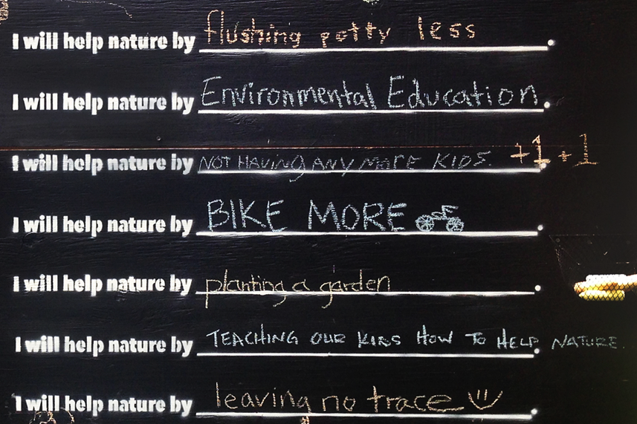
Student installation for Project Preparation, Before I Die, I will help nature by...Project, Art Institute of St. Louis, 2015

Slide 19


Morgan Stevenson, Advanced Photo & Design, View Flipbook for Catalog Design, Art Institute of St. Louis, 2015

Slide 20
Emily Chiodini,
View Flipbook for Magazíne Design Assignment,
Advanced Photo & Design – Project Preparation, Art Institute of St. Louis, 2016

Slide 21

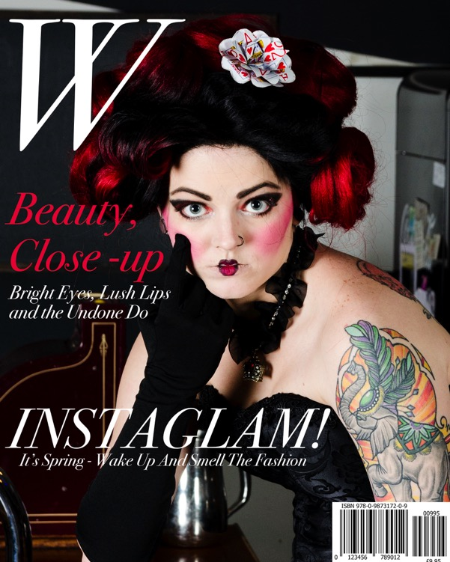
Megan Vincent & Sharon Dauster, Magazíne Design Assignment, Advanced Photo & Design – Project Preparation, Art Institute of St. Louis, 2016

Slide 22
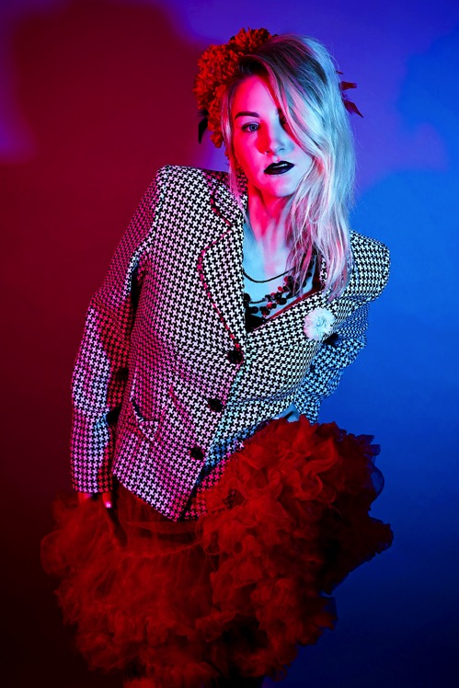
Leah Schnarre,
Fashion Photography,
Capstone Class, Art Institute of St. Louis, 2016
Notes:
Leah Schnarre

Slide 23
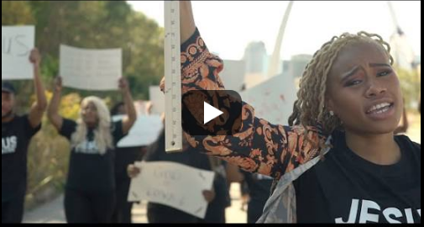
Leslie Hardin, Jesus is the Greatest -Music Video, Advanced Photo, Final Project, 2020
https://www.youtube.com/watch?v=jO8dnjmD3pQ
Notes:
https://www.youtube.com/watch?v=jO8dnjmD3pQ

